Slide 1
Types of Constraint

Slide 2
Types of Constraints in SQL
NOT NULL Constraint − Ensures that a column cannot have NULL value.
DEFAULT Constraint − Provides a default value for a column when none is specified.
UNIQUE Constraint − Ensures that all values in a column are different.
PRIMARY Key − Uniquely identifies each row/record in a database table.
FOREIGN Key − Uniquely identifies a row/record in any of the given database table.
CHECK Constraint − The CHECK constraint ensures that all the values in a column satisfies certain conditions.

Slide 3
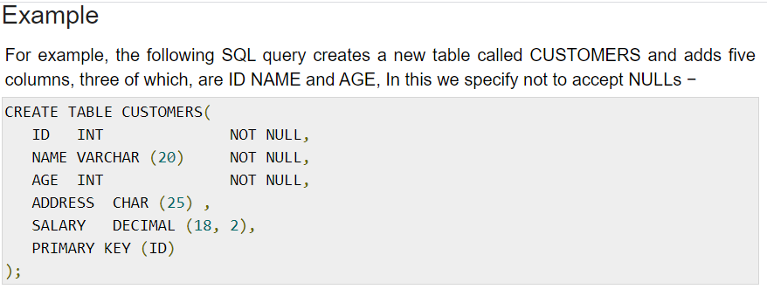
Null Constraint
A NULL is not the same as no data, rather, it represents unknown data.

Slide 4
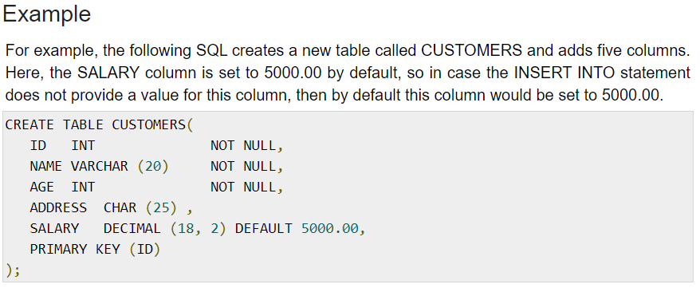
Default Constraint
The DEFAULT constraint provides a default value to a column when the INSERT INTO statement does not provide a specific value.

Slide 5
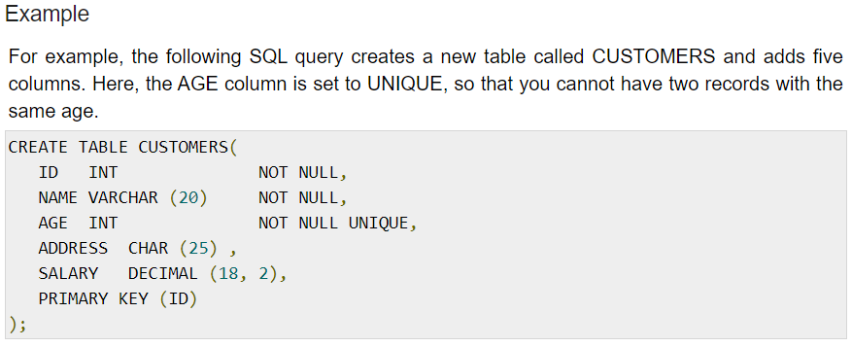
Unique Constraint
The UNIQUE Constraint prevents two records from having identical values in a column. In the CUSTOMERS table, for example, you might want to prevent two or more people from having an identical age.

Slide 6
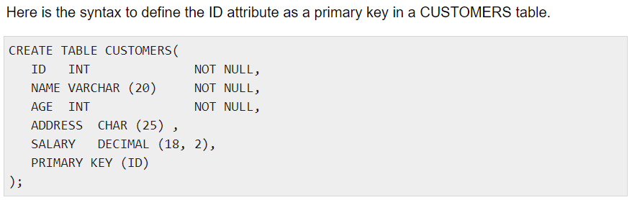
Primary Key
A primary key is a field in a table which uniquely identifies each row/record in a database table. Primary keys must contain unique values.
A primary key column cannot have NULL values.

Slide 7
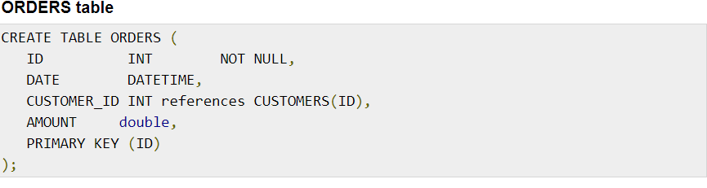
Foreign Key
A foreign key is a key used to link two tables together. This is sometimes also called as a referencing key.
A Foreign Key is a column or a combination of columns whose values match a Primary Key in a different table.

Slide 8
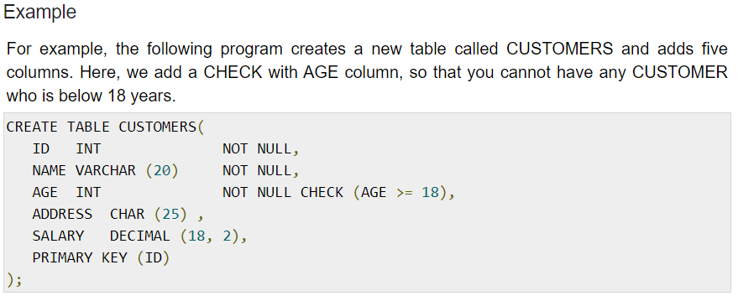
Check Constraint
The CHECK Constraint enables a condition to check the value being entered into a record. If the condition evaluates to false, the record violates the constraint and isn't entered the table.

